Slide 2
Completed User stories
10 stories completed
More functionality into current app
Communication

Slide 3
Completed Stories: JavaFx review
Reviewed the basics of JavaFx
Mainly how to create interactions from users to the app

Slide 4
Completed Stories: Create the framework for the admin app
Created the backbone of the app using JavaFx
Used a bean and view class
Bean class encapsulates various objects into one
View class creates instances of each component when used by the main class

Slide 5
Completed stories: Create methods that will provide envisioned functionality
Methods include:
Reading data from database and return into list
Update specific users
Compiling data into CSV format
Each method has its own return type

Slide 6
Completed Stories: Connecting to the database
Communicated with back end
Database authorization will use Http requests
Requests include PUT/POST/GET etc.

Slide 7
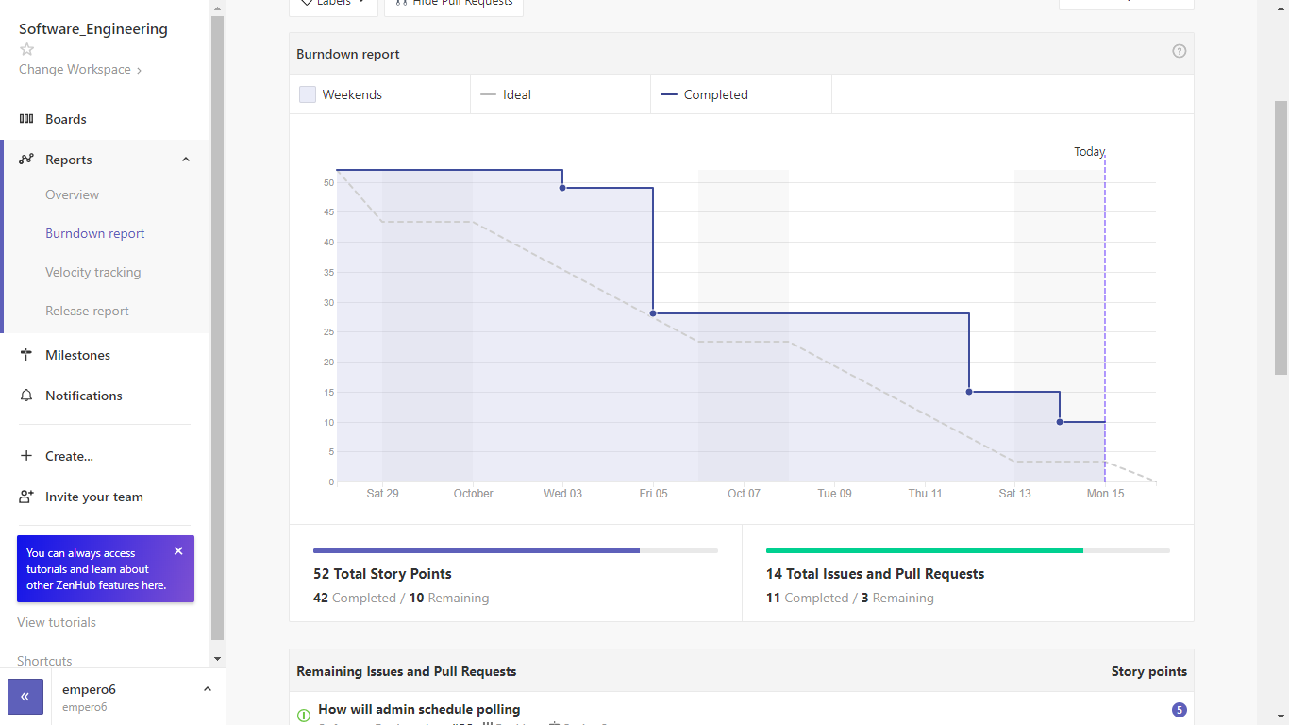
Scrum Burndown Chart

Slide 8
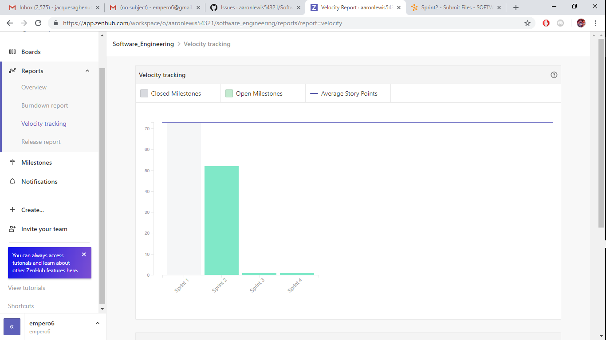
Velocity Chart

Slide 9
Team Backlog
Further functionality with admin app

